Slide 1
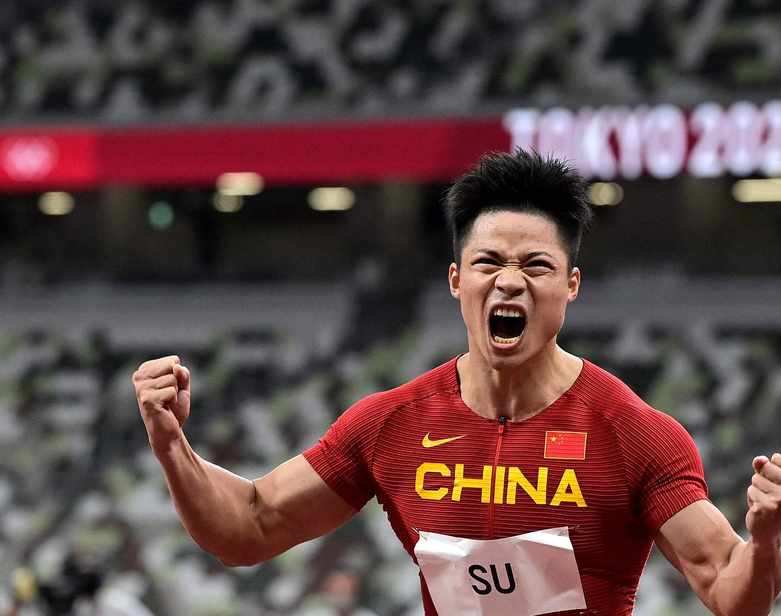
Who holds the Asian record for the Men’s 100 meters?
Bingtian Su（苏炳添）
9.83s

Slide 2
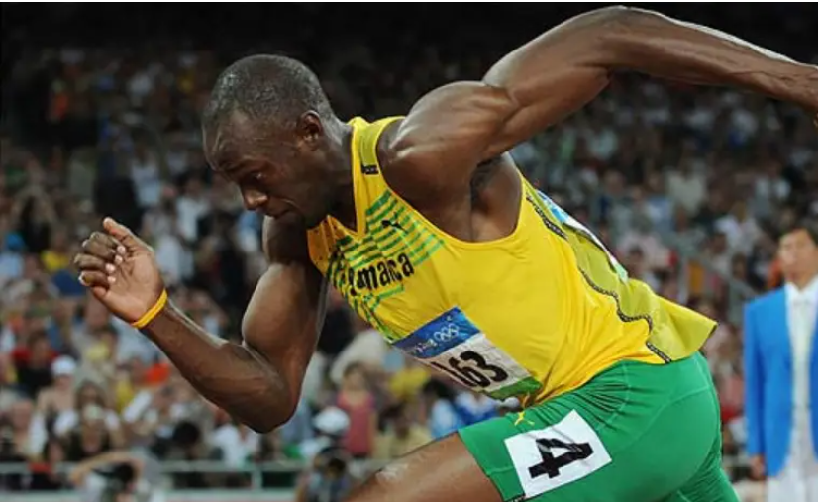
Predicting
2024 Paris Olympic Games Men’s 100m

Slide 3
Introduction to the Group

Slide 4

Youyao Gao
Gender: Male
Nationality: China
Hometown: Shanghai
College: University of Nottingham Ningbo China
Emial: scyyg6@nottingham.edu.cn
youyaogao@gmail.com
15221996168@163.com
Contact Number: +86 15221996168
Computer skills: Python, C, java, Haskell, SQLite, HTML, CSS, Matlab, R, Geogebra, Latex
Language skills: English, Mandarin
Research interest: Data Science, Machine Learning, Computer Vision

Slide 5

Yu Liang
Gender: MALE
College: SUSTech
Major: Computer Science
Email: 12212355@mail.sustech.edu.cn
Skills: Java, Python, C/C++
Interests: Machine Learning, Operation System, Network

Slide 6
Haosong Sun
Gender: MALE
College: Beijing University of Posts and Telecommunications
Major: Electronic Information Engineering
Email: mrsun666@126.com
shs2022@bupt.edu.com
Skills: C/C++, Python, MATLAB
Interests: Machine Learning, Deep Learning, Signal Processing

Slide 7

XinYi Zeng
Gender: FEMALE
College: Southern University of Science and Technology
Major: Data Science
Email: 12212355@mail.sustech.edu.cn
Skills: Java, Python, R
Interests: Machine Learning, Deep Learning, Data Analysis

Slide 8
Outline
1. Pre-Project Preparations
· Waterfall Method and Agile Method
2. Development
· Data Collection
· Data Preprocessing
· Feature Engineering
· Logistic Regression
· Model Building, Training, and Testing
3. Conclusion

Slide 9
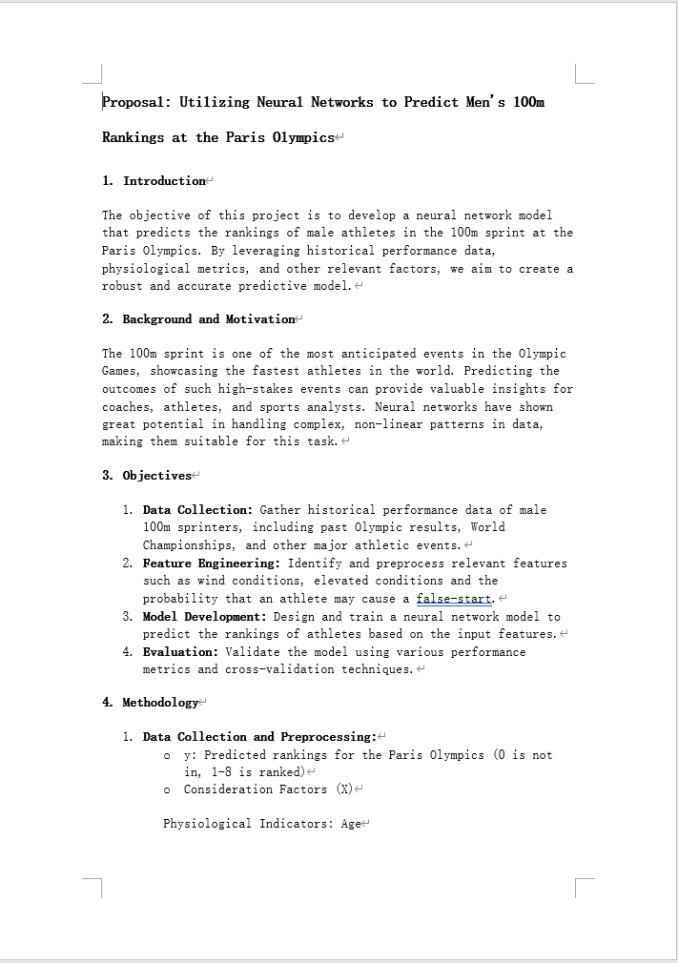
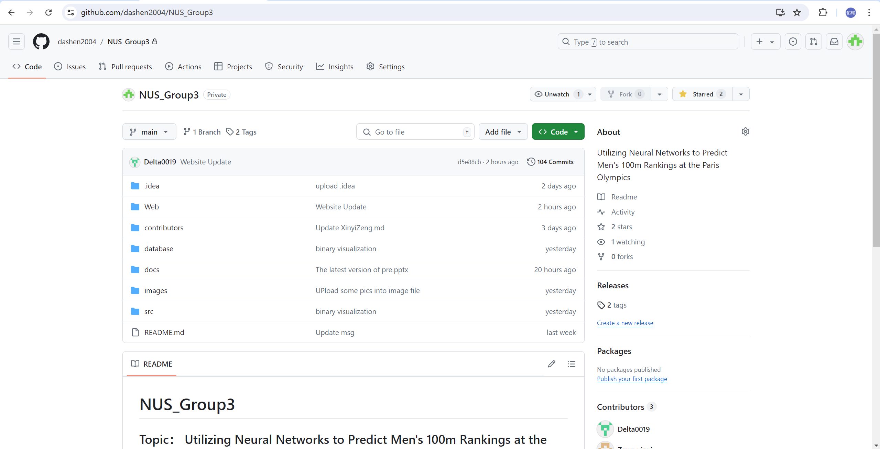
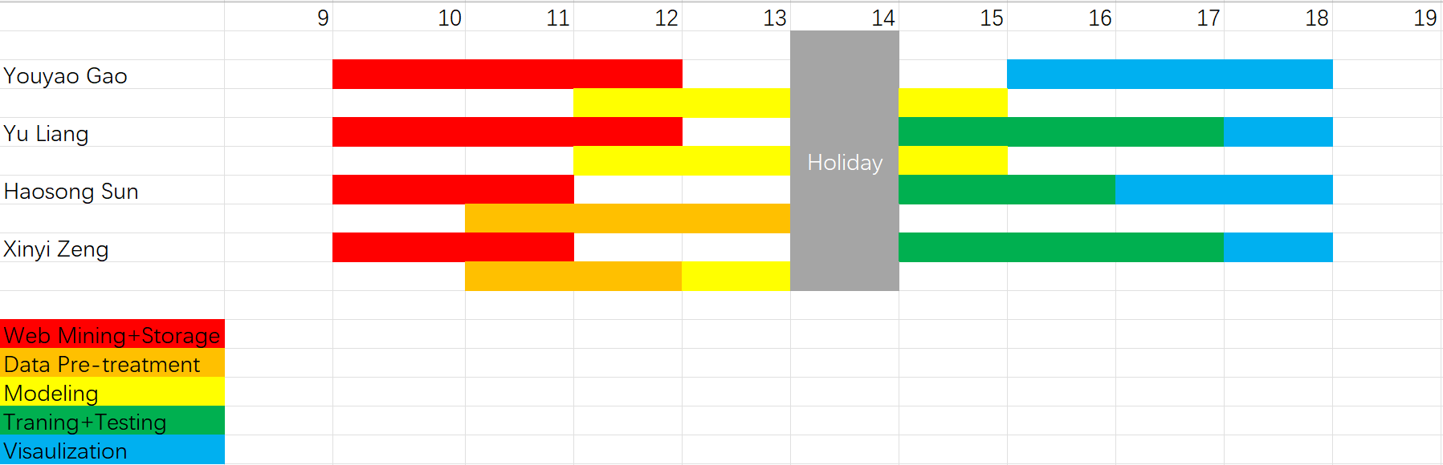
Pre-Project Preparations: Waterfall Method and Agile Method

Slide 10
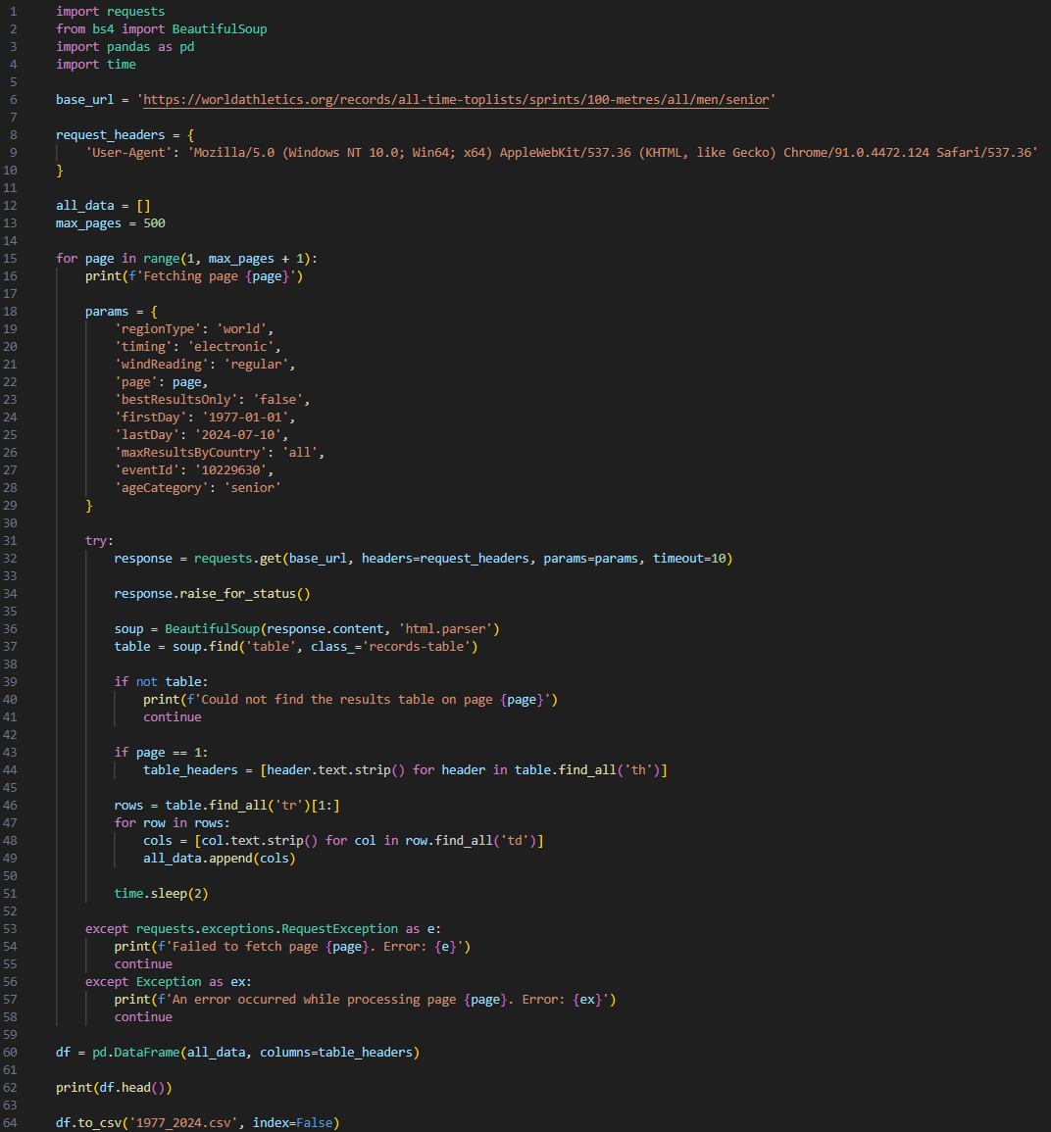
Development : Data Collection
https://https://worldathletics.org/athletes
(World Athletics, 2024)

Slide 11
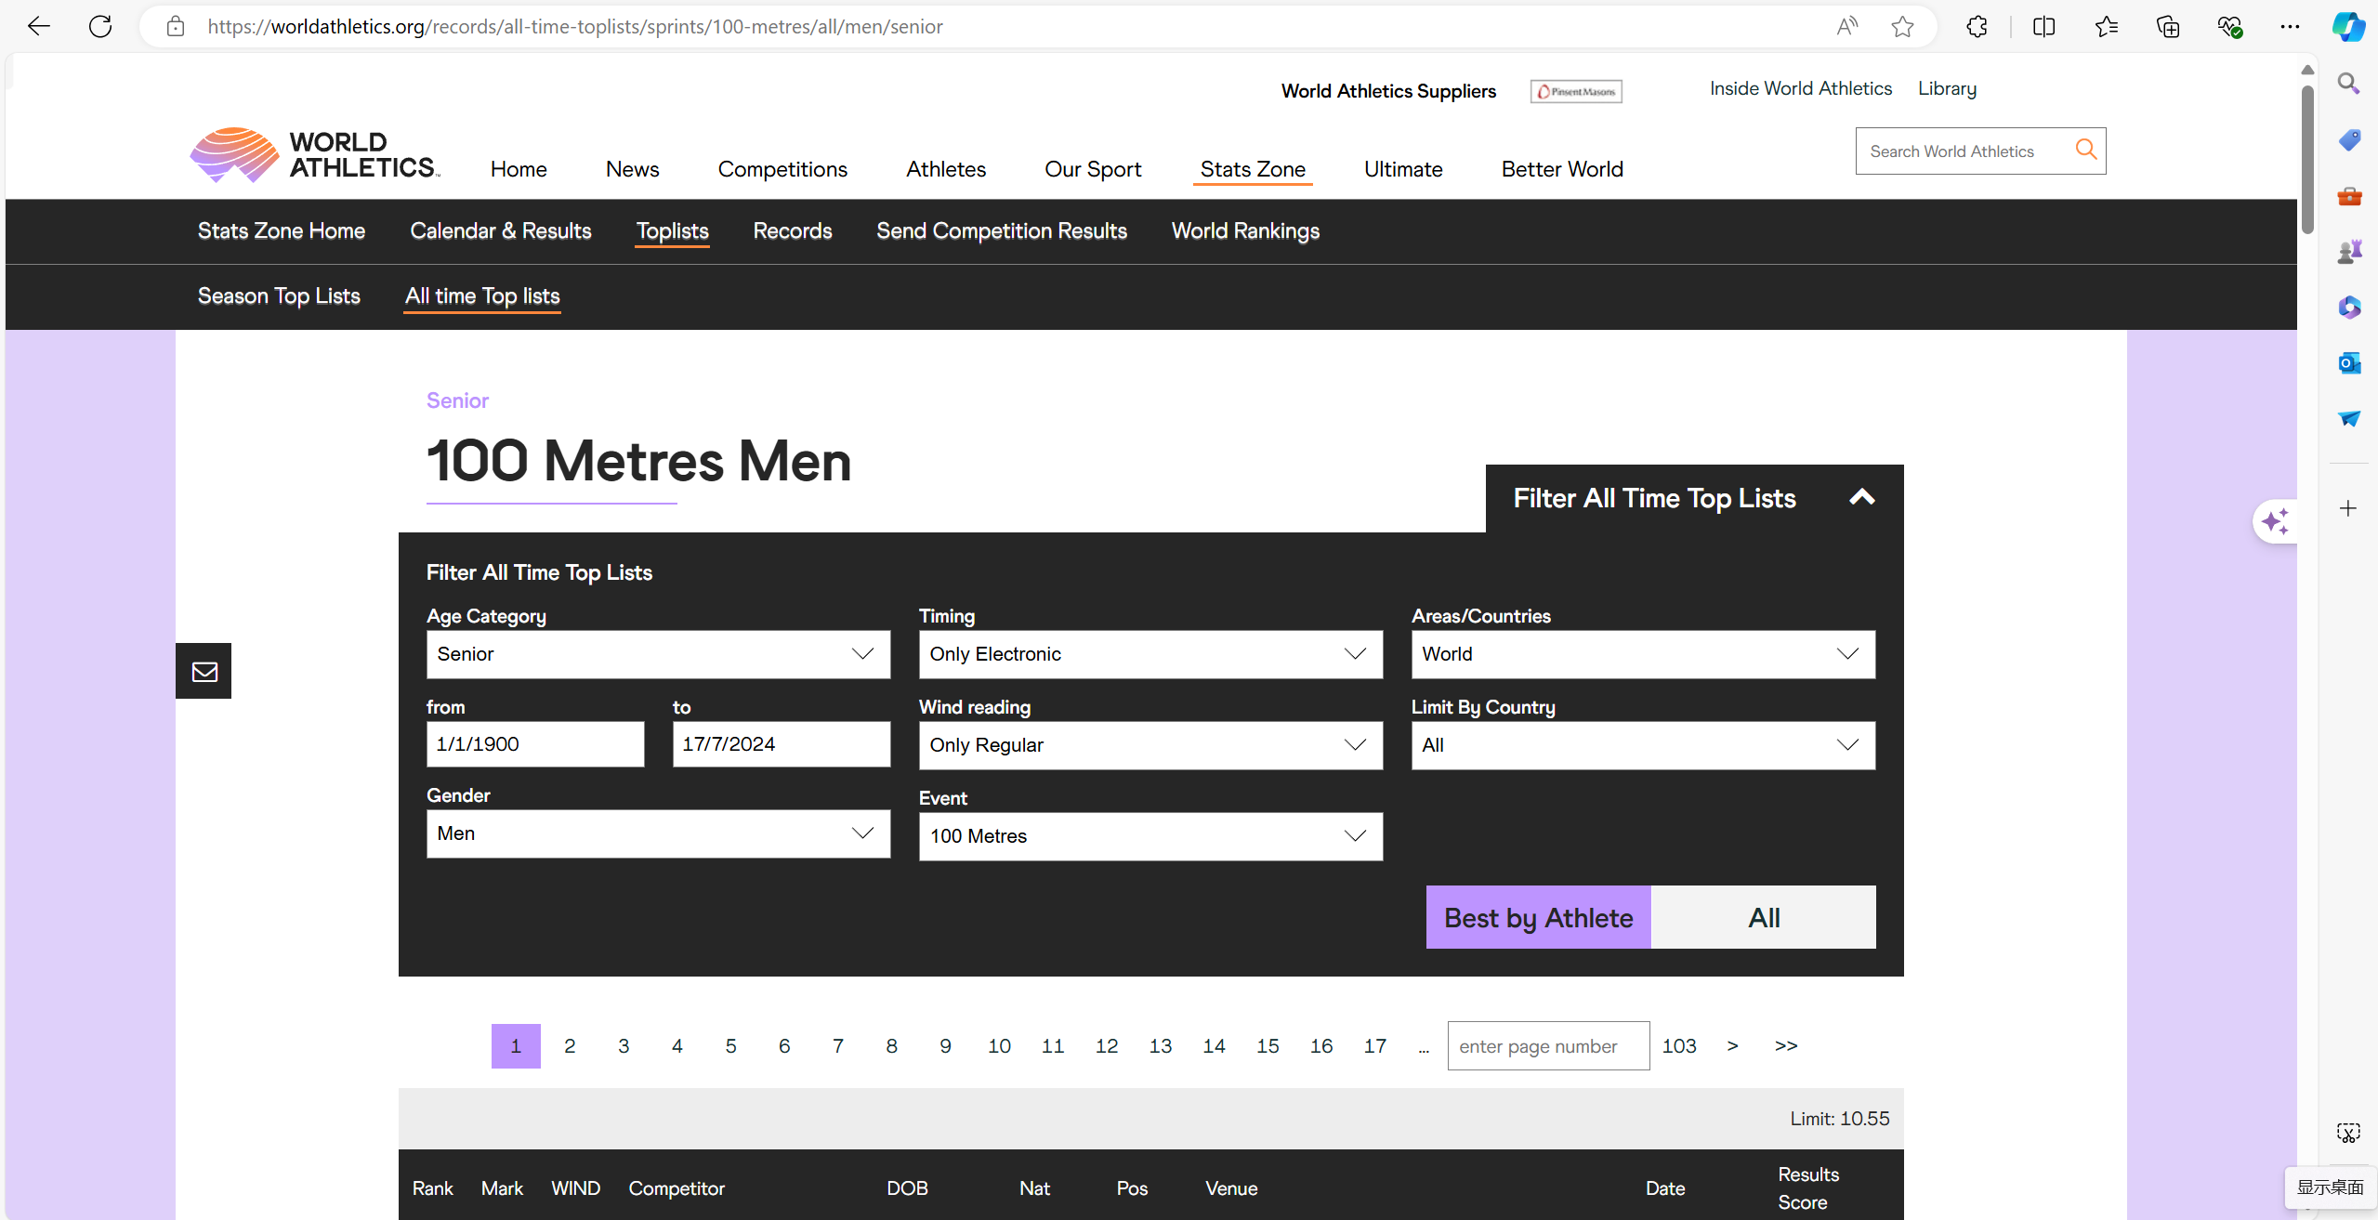
(World Athletics, 2024)

Slide 12
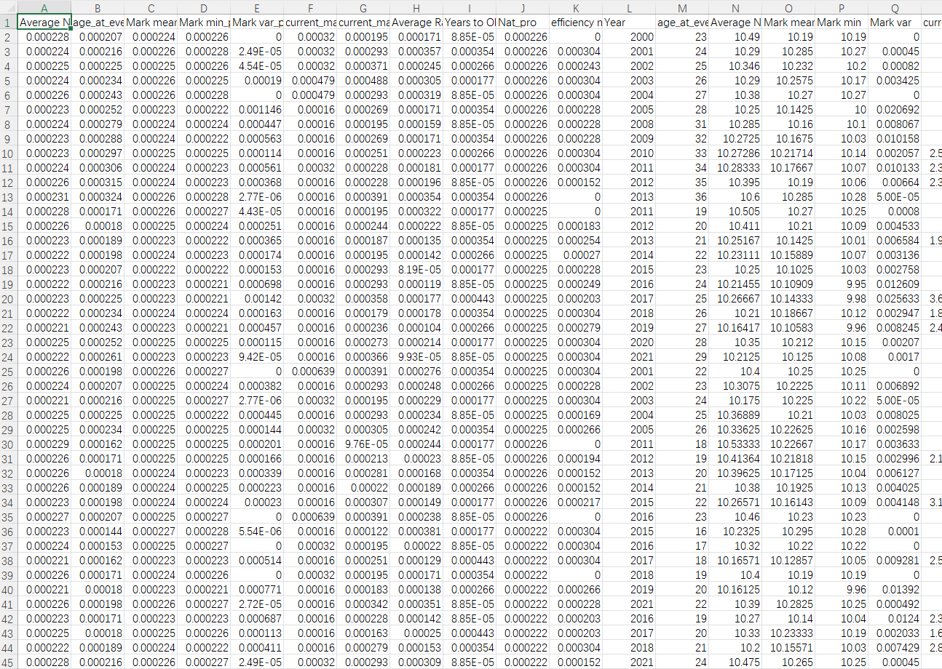
Development : Data Preprocessing
Focus on raw data
*Red marks are important data source
Model Assumption:
1) The ability of an athlete to reach the finals is determined by their performance over the past four years.
2) It disregards the potential errors and the impact of the special characteristics of opponents that may occur in the actual Olympic competition.
Rank | Mark | WIND | Competitor | DOB | Nat | Pos | Venue | Date | Result score

Slide 13
Development : Data Preprocessing
Remove records of athletes with fewer than 10 total records
(except for Kishane THOMPSON)
Process the blank and anomalous values
415 missing values: 415(1.14%)
'NW' (‘WIND’ column): 256 (0.7%)
'W'(‘WIND’ column): 157 (0.4%)

Slide 14
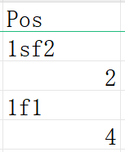
Development : Data Preprocessing
Data Formatting(‘Pos’, ‘DOB’)
Introduce new data dimensions
1. ‘Net result ’ [ Empirical Formula ] Net result = Mark + 0.1*WIND
2. 'effective_score'(0/1): the wind speed impact between -2 or 2 seconds
3. ‘National Score’: The average of the final scores of the athletes’ country.

Slide 15
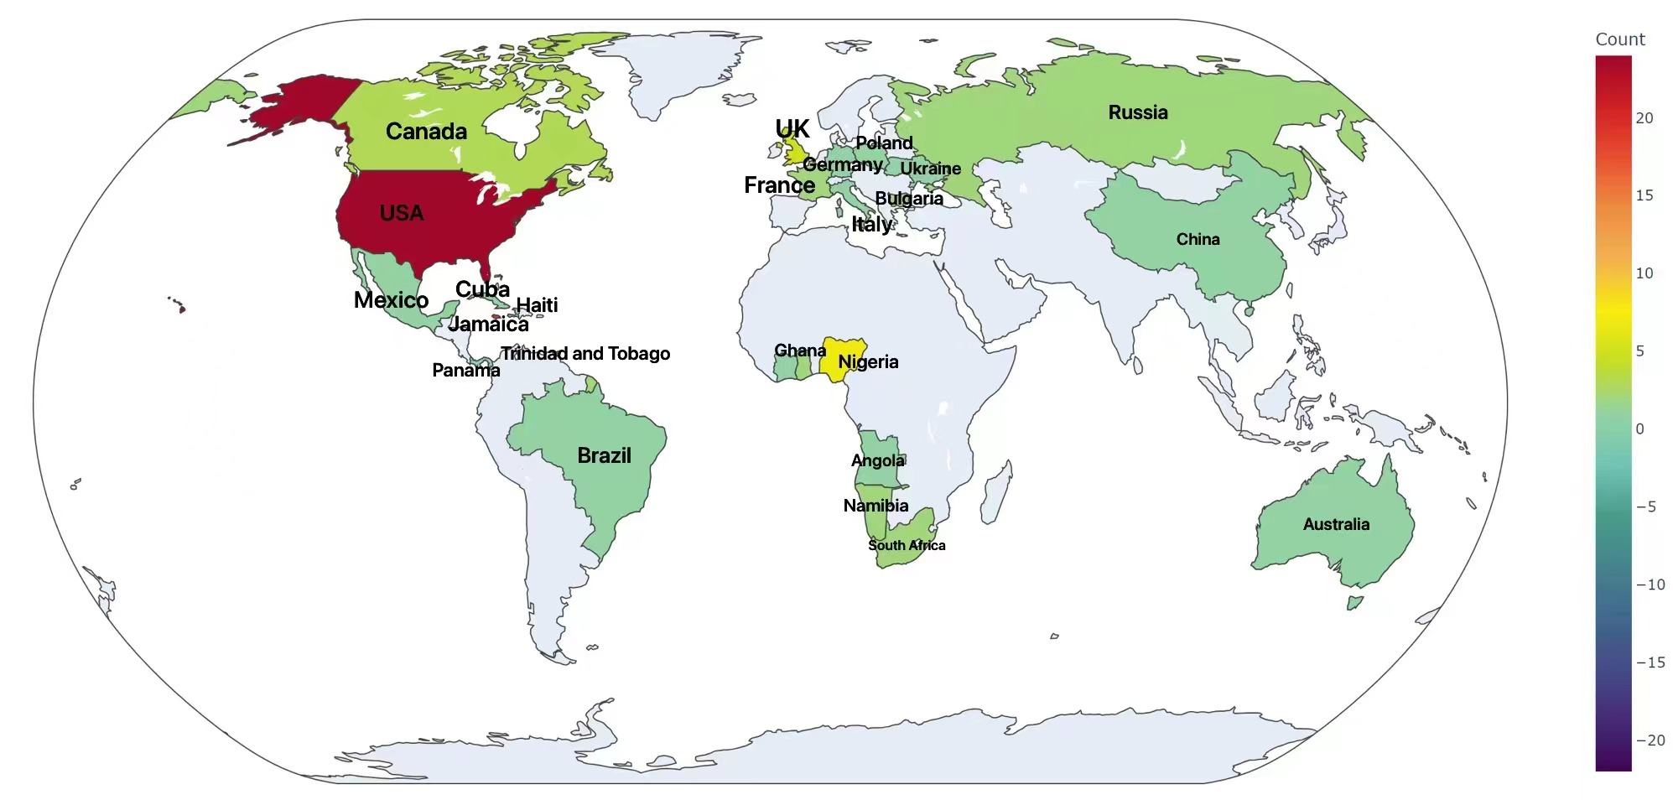
‘National Score’ supplement
The countries of origin for athletes who entered the Men's 100 meters final at the Olympics
country | count
USA | 24
Jamaica | 19
Nigeria | 7
Trinidad and Tobago | 6
Naturalized athlete ratio: 8.2%
United States of America | 24
Jamaica | 19
Nigeria | 7
United States of America | 24
Jamaica | 19
Nigeria | 7
United States of America | 24
Jamaica | 19
Nigeria | 7
United States of America | 24
Jamaica | 19
Nigeria | 7

Slide 16
Development : Data Preprocessing
Predictor Variables：
- Age at event
- Average Net Result mean
- Mean mark
- Best mark (min)
- Variance of the mark
- Mean match ranking
- Best match ranking (min)
- Average Rank mean
- Mean efficiency
- Nation Score
- Years to Olympics
Response Variables：
1 Finalist_weight(0/1): whether they entered the final
2 Olympic Ranking
Secondary processing to identify potential influencing factors (slice the data by year)
* Perform another round of missing data and outlier handling

Slide 17
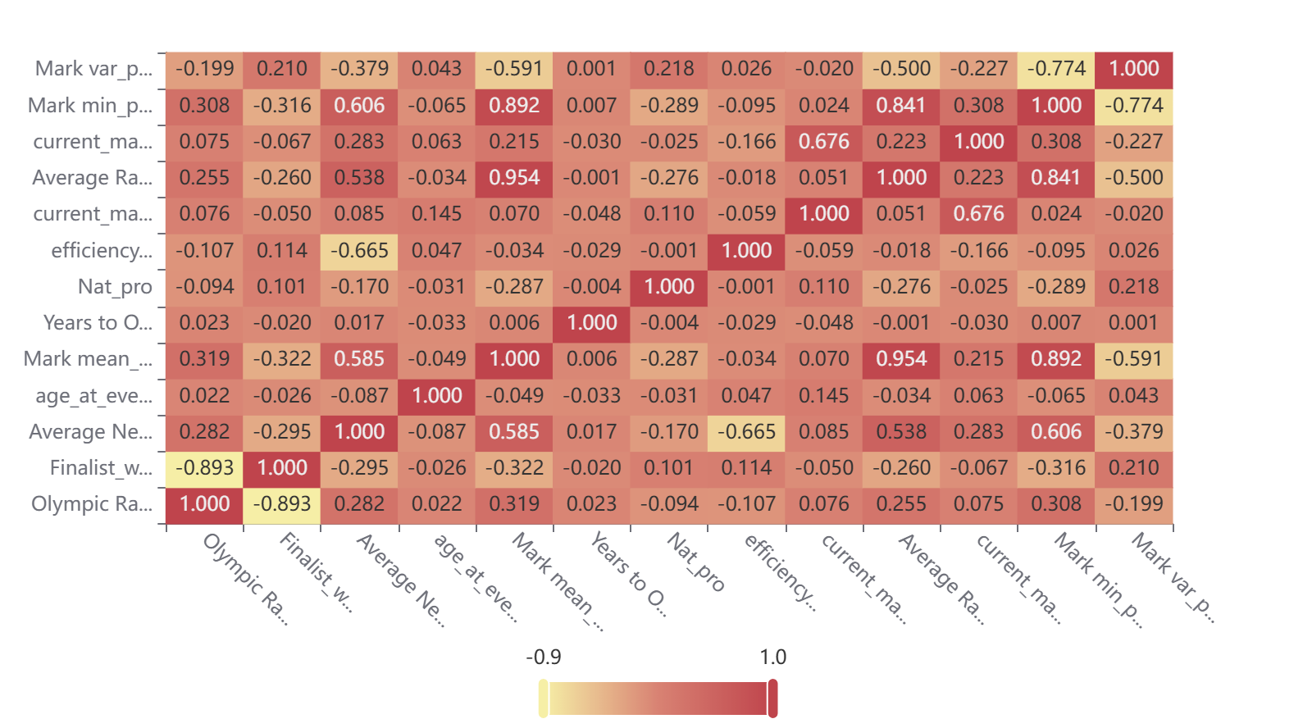
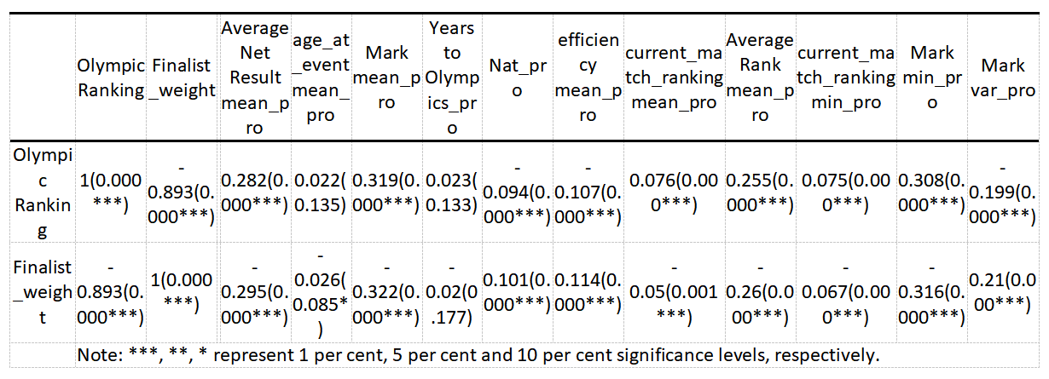
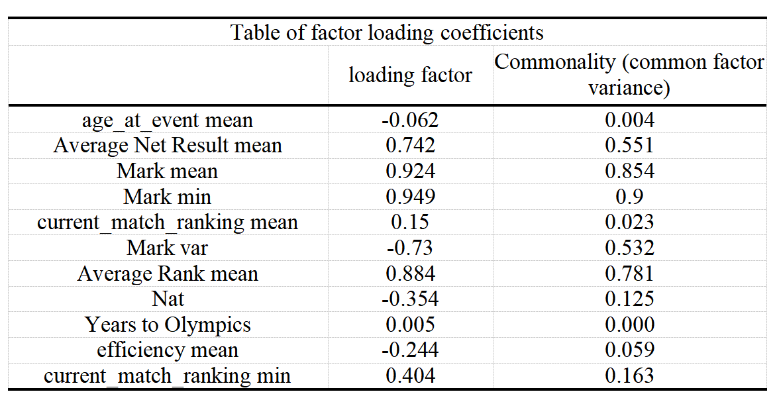
Development :
Feature Engineering
Pearson correlation analysis

Slide 18
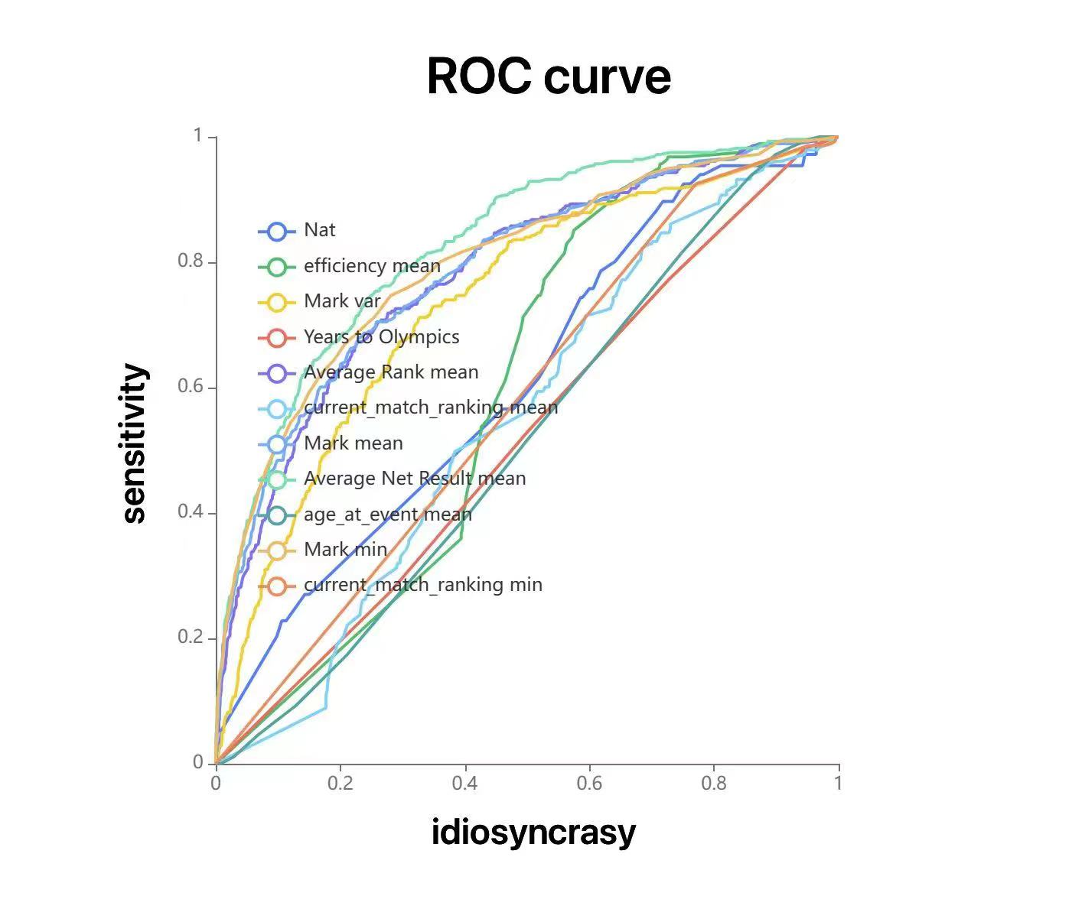
Development : Feature Engineering
ROC curve
(classification effect)
State variable: Finalist_weight

Slide 19
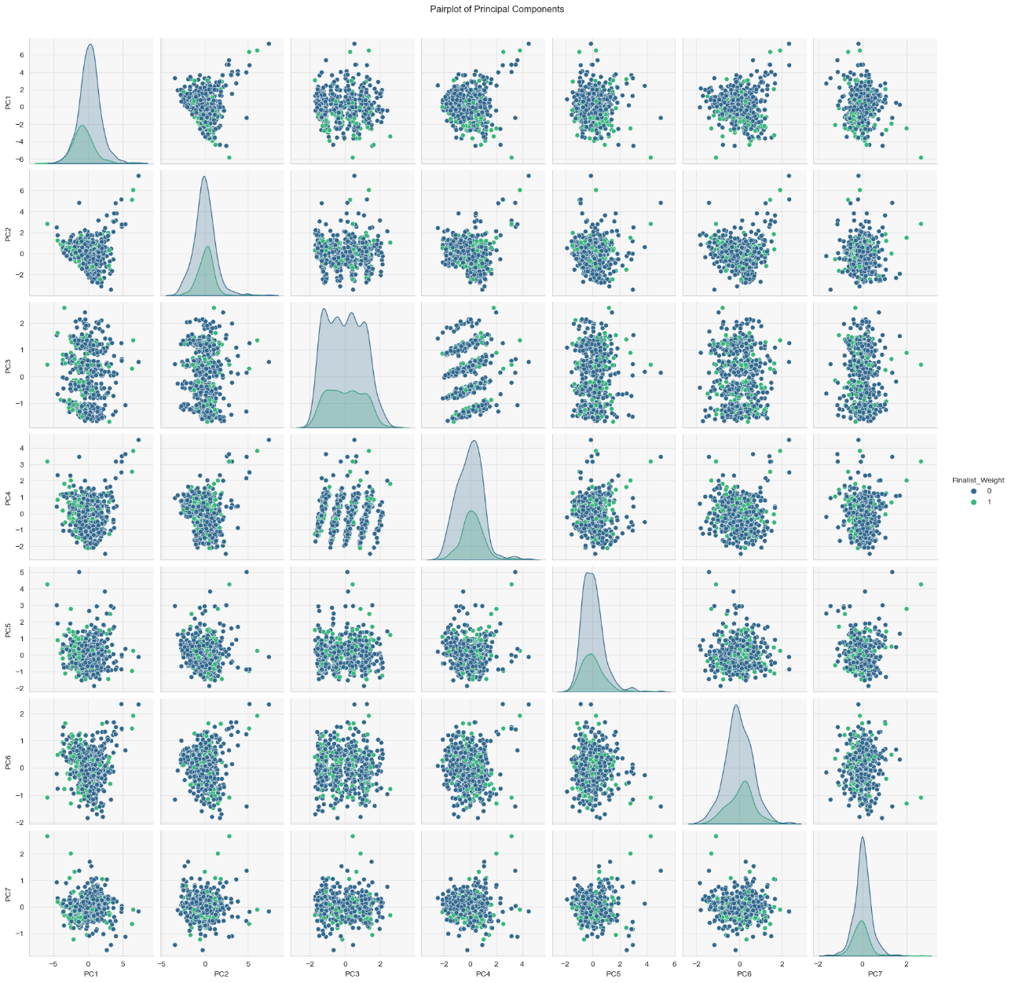
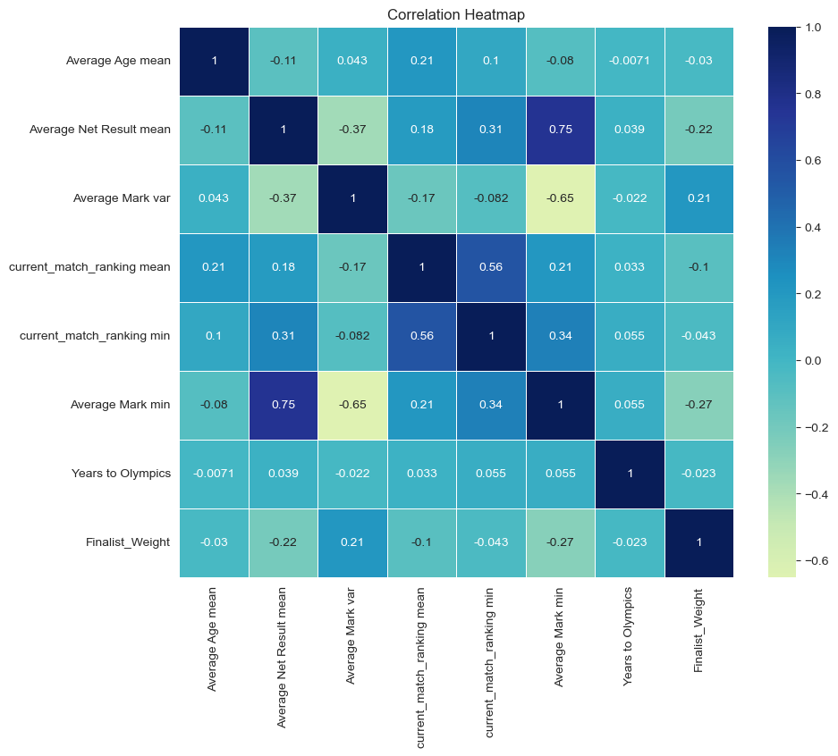
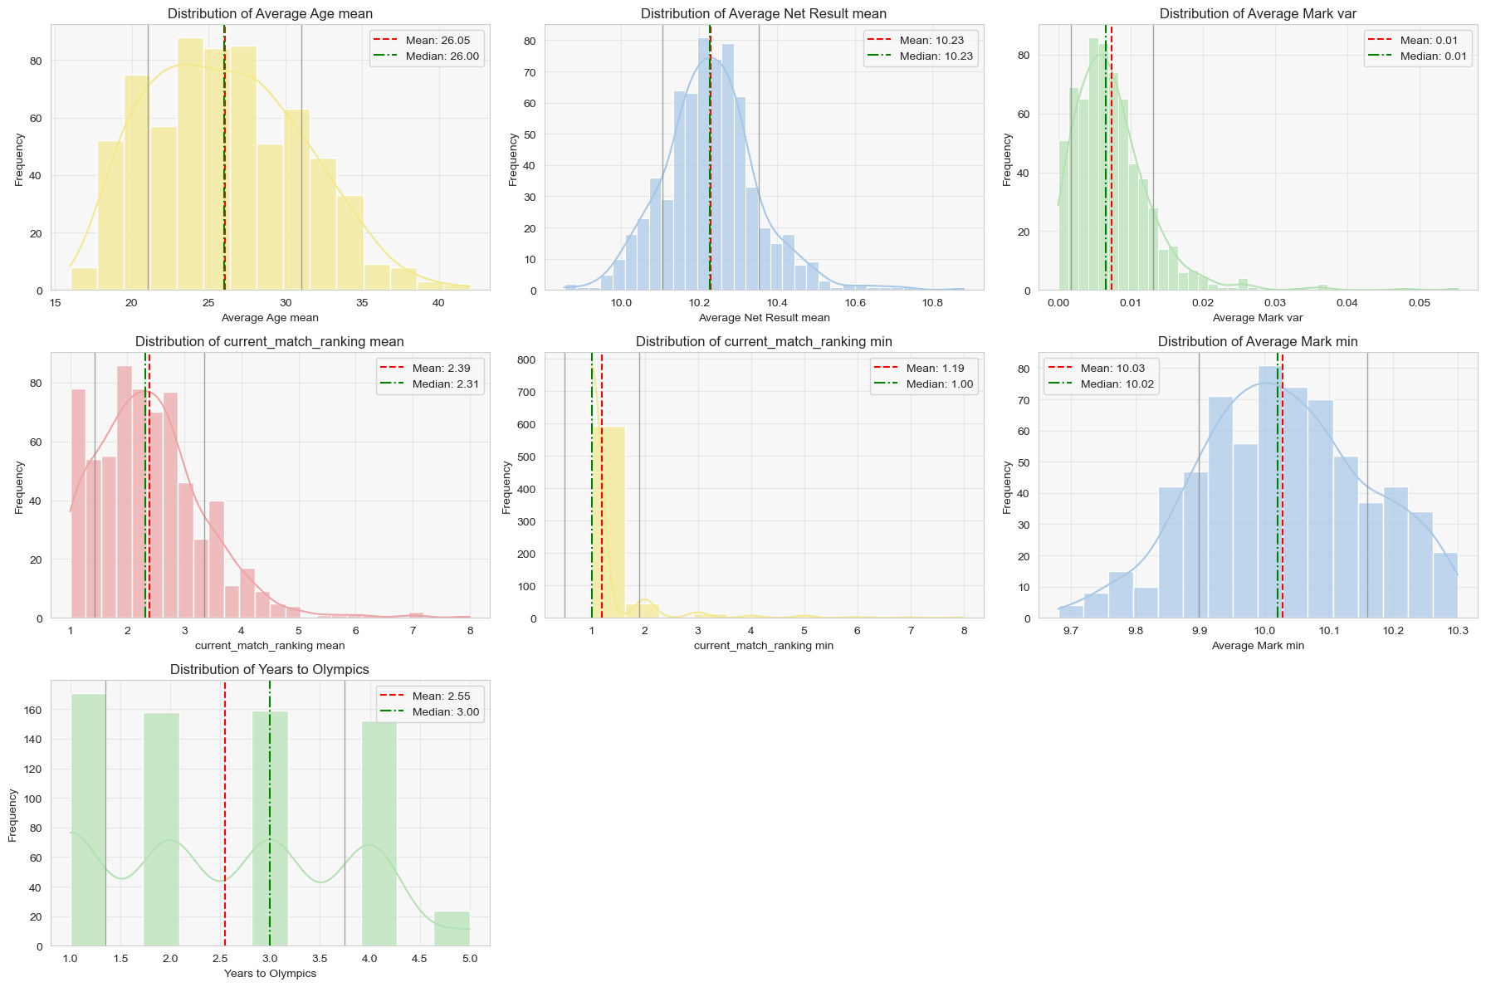
Development : Logistic Regression

Slide 20
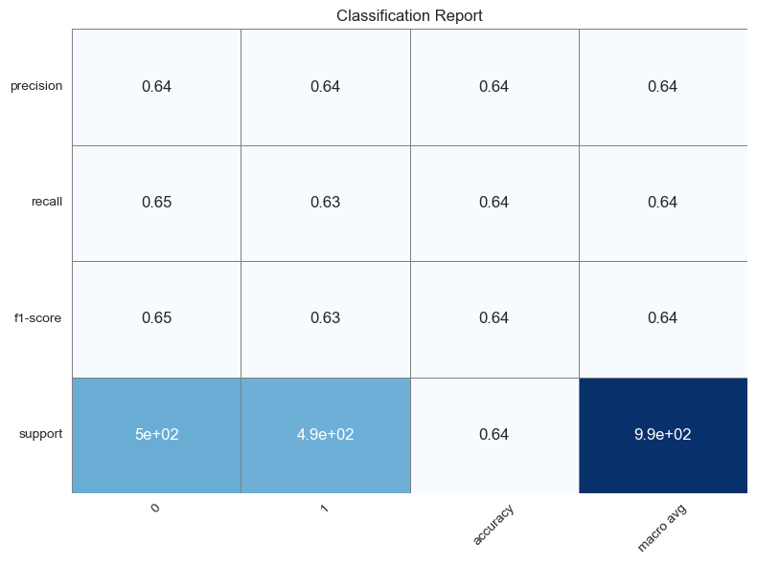
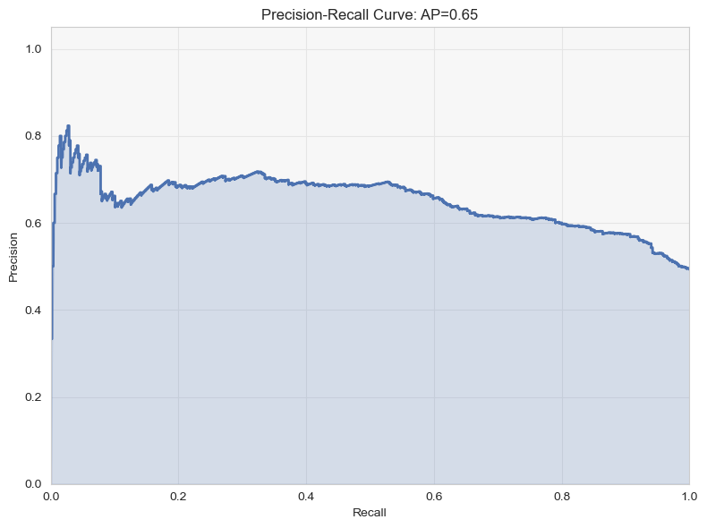
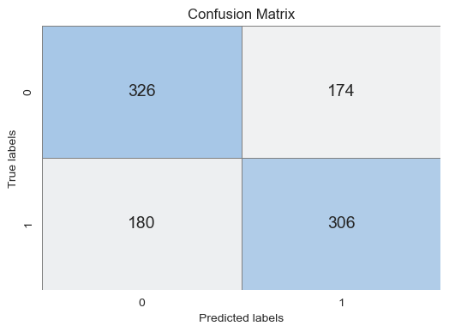
Development : Logistic Regression

Slide 21
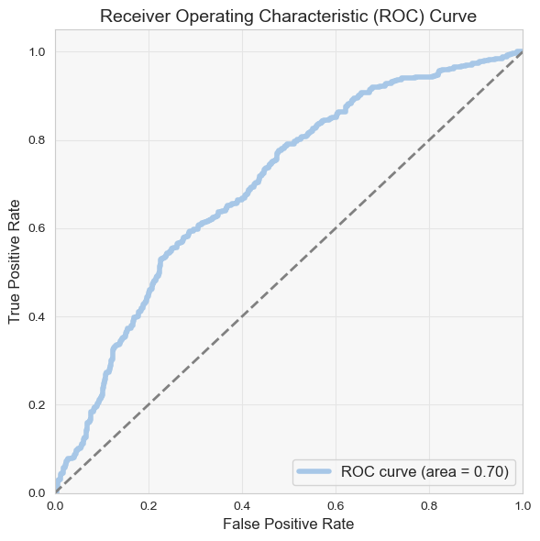
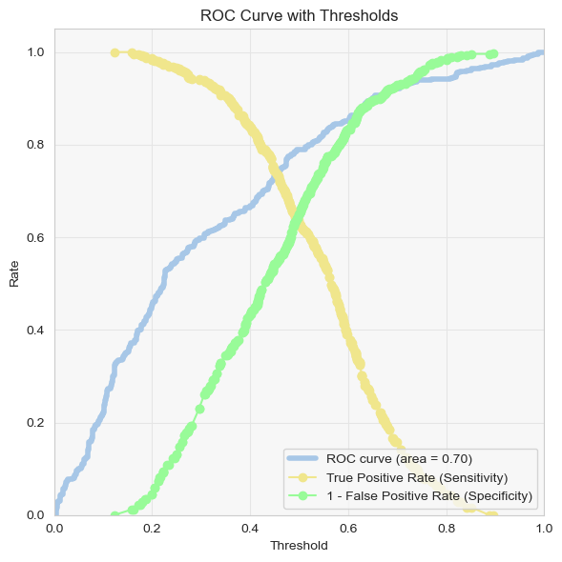
Development : Logistic Regression

Slide 22
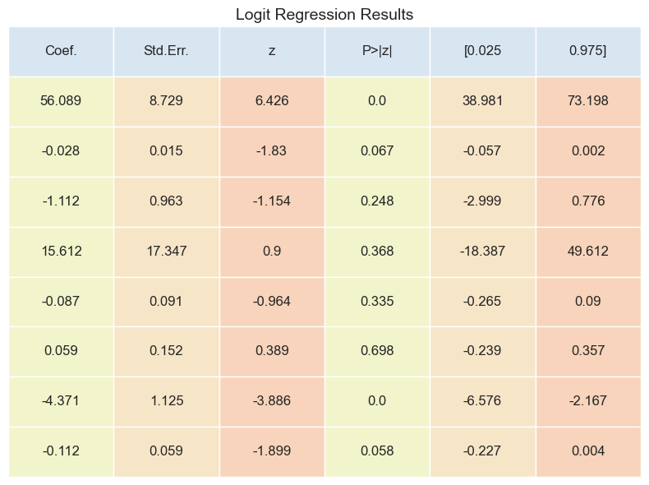
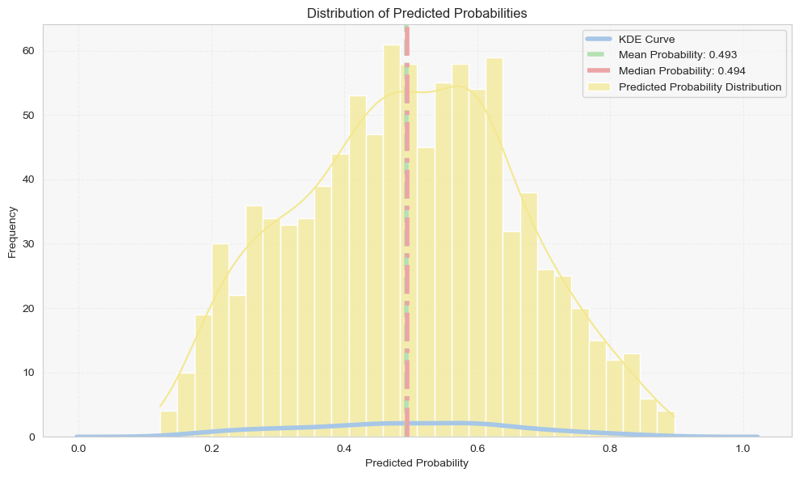
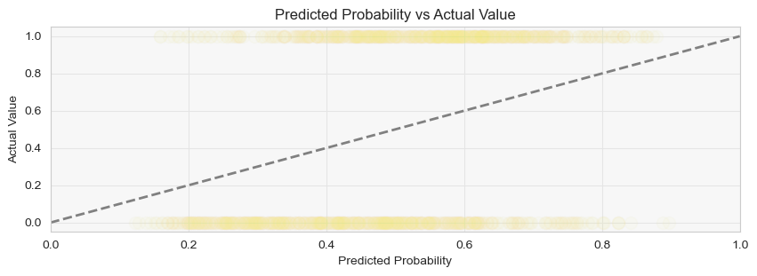
Development : Logistic Regression

Slide 23
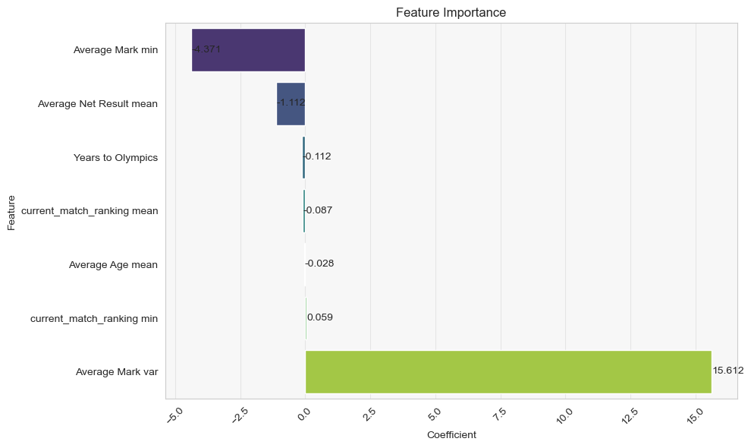
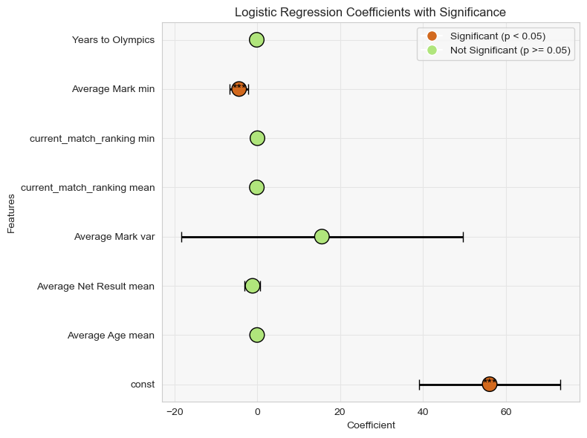
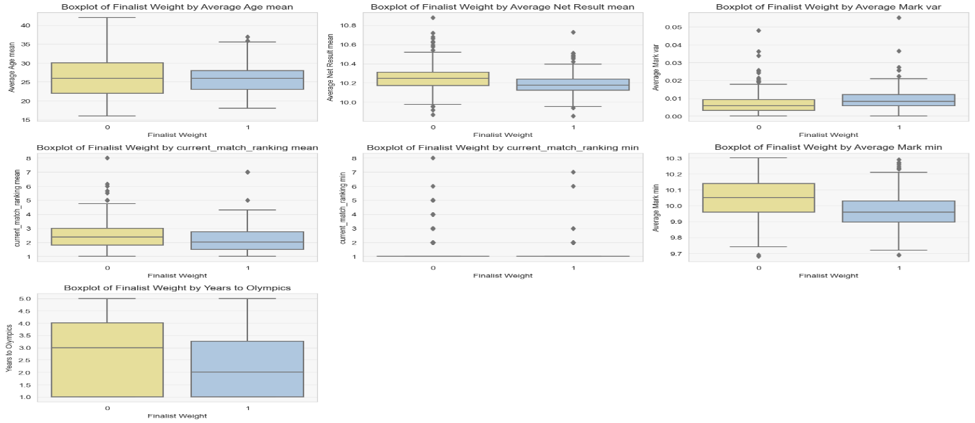
Development : Logistic Regression

Slide 24
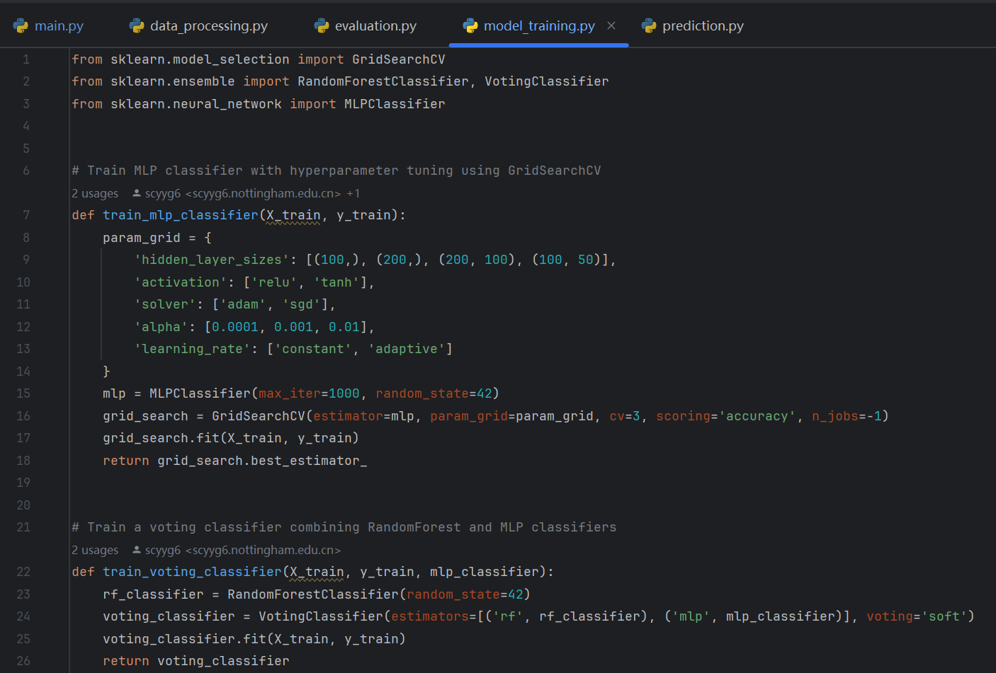
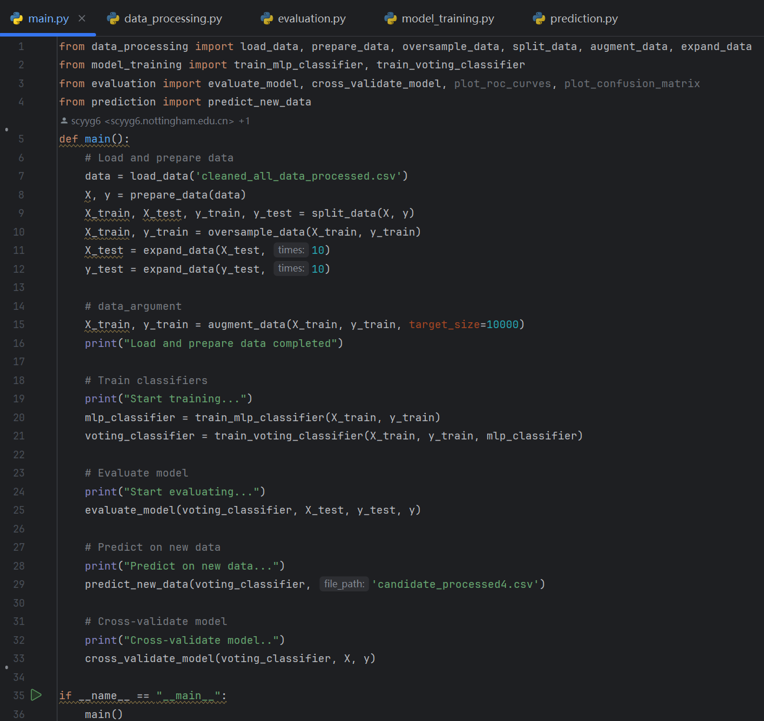
Development : Model Building, Training, and Testing
(Brownlee, 2024)
(Zuoyuan, 2023)

Slide 25
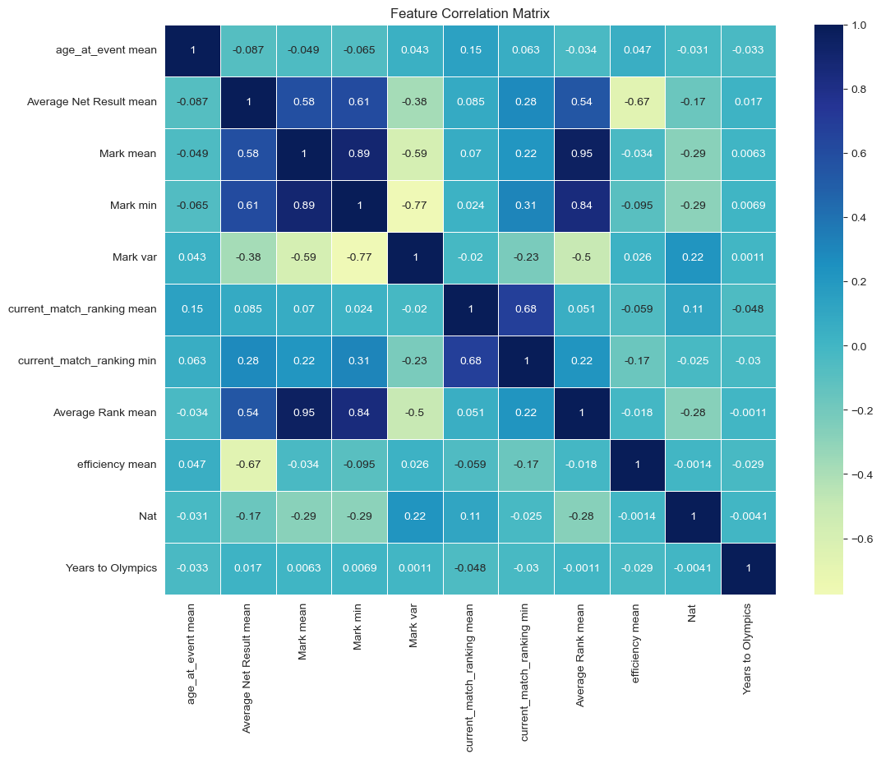
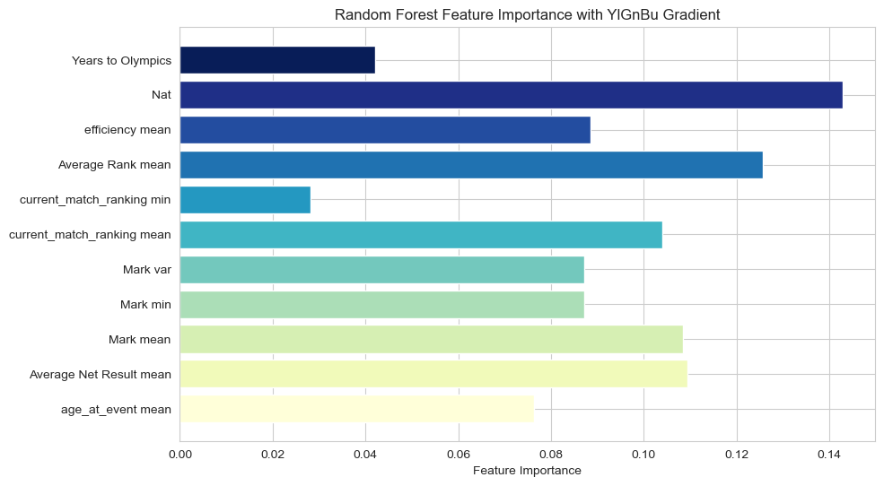
Model Building: Random Forest

Slide 26
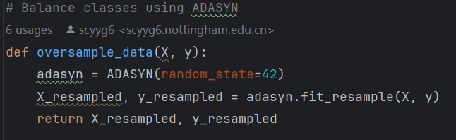
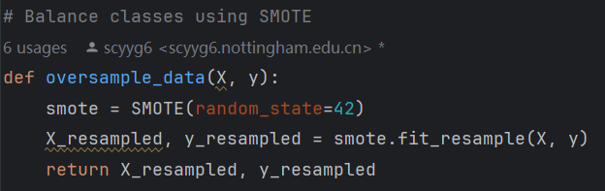
Development: SMOTE and ADASYN
(Brownlee, 2024)
(ApacheCN, 2023)

Slide 27
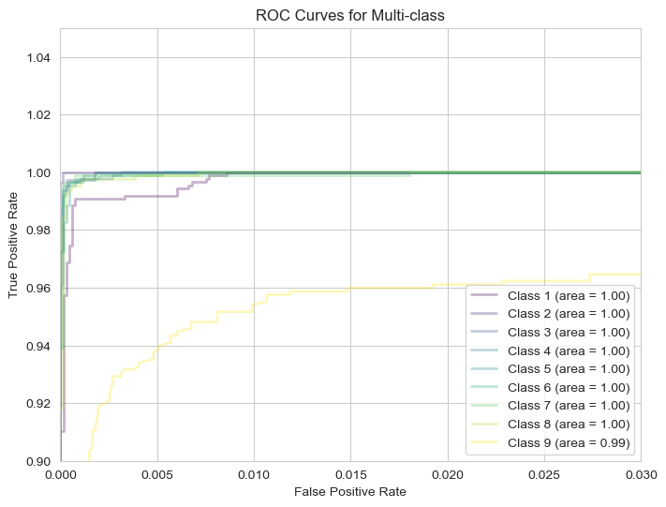
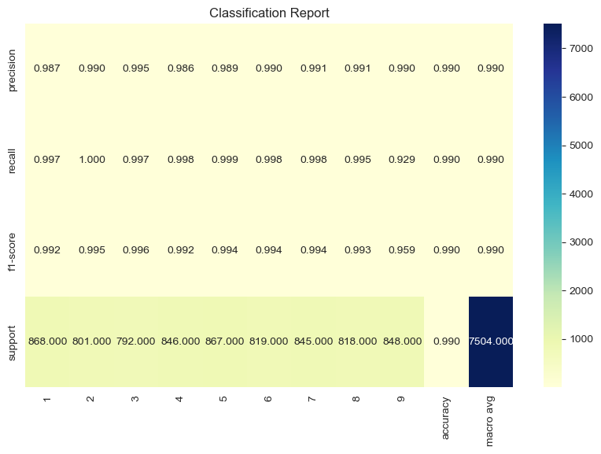
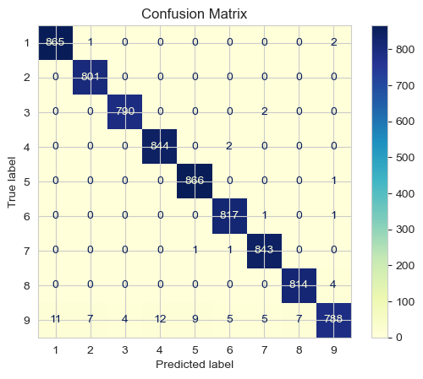
Development: SMOTE and ADASYN

Slide 28
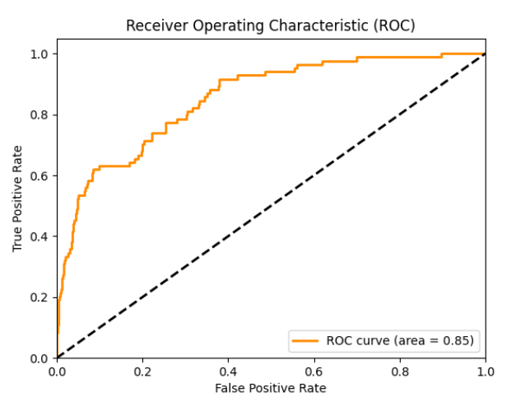
Development: Correct Test Case

Slide 29
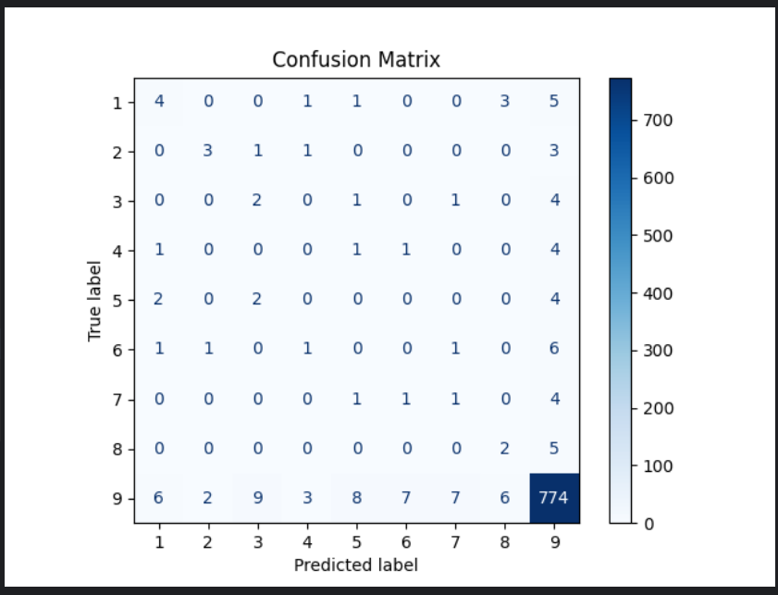
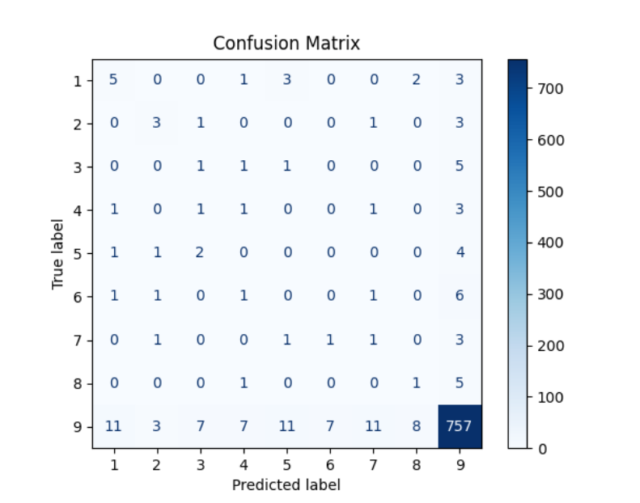
Development: Data Augmentation
While the overall results did not show significant improvement, class 9 indicates that the model's overfitting issue has been somewhat mitigated

Slide 30
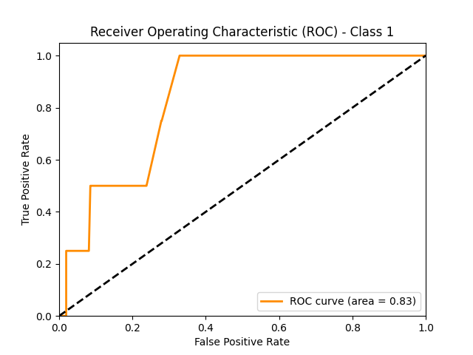
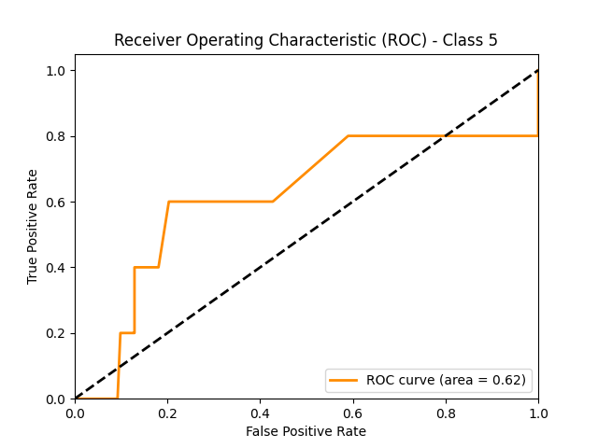
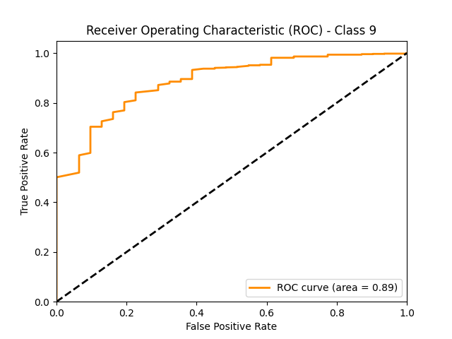
Development: Further thoughts on Accuracy
The accuracy of simply randomly partitioning the data is overestimated, and we can only predict future data based on past data.
Average accuracy: 0.87 -> 0.74

Slide 31
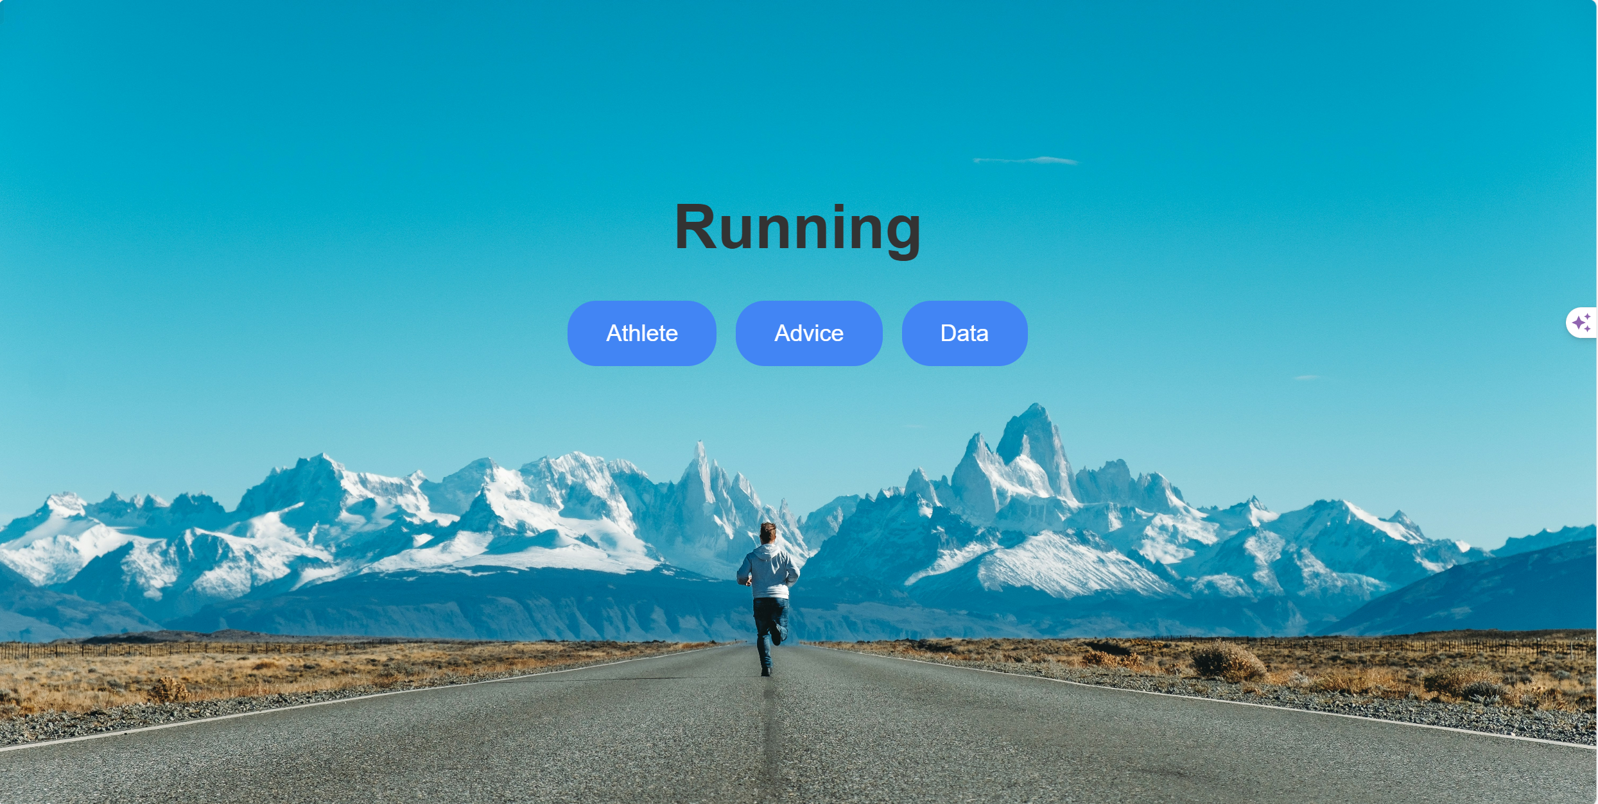

Slide 32
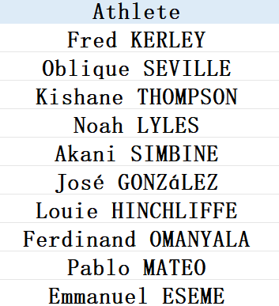
Conclusion
Evaluation of logistic regression model
Evaluation of the random forest model
Predicte ranking

Slide 33

THANK YOU!

Slide 34
Reference List
ApacheCN. (2023) SMOTE oversampling for imbalanced classification. Available at: https://github.com/apachecn/ml-mastery-zh-pt2 (Accessed: 12 July 2024).
Brownlee, J. (2024) How to Develop a Random Forest Ensemble in Python. Available at: https://machinelearningmastery.com/random-forest-ensemble-in-python/ (Accessed: 12 July 2024).
Brownlee, J. (2024) Random Oversampling and Undersampling for Imbalanced Classification. Available at: https://machinelearningmastery.com/random-oversampling-and-undersampling-for-imbalanced-classification/ (Accessed: 12 July 2024).
scikit-learn. (2024) Cross-validation: evaluating estimator performance. Available at: https://scikit-learn.org/stable/modules/cross_validation.html (Accessed: 9 July 2024).
World Athletics. (2024) Letsile Tebogo. Available at: https://https://worldathletics.org/athletes (Accessed: 8 July 2024).
Zuoyuan, C. (2023) A Complete Machine Learning Project. Available at: https://github.com/confucianzuoyuan/python-tutorials/blob/master/python-data-analysis/docs/2.%E4%B8%80%E4%B8%AA%E5%AE%8C%E6%95%B4%E7%9A%84%E6%9C%BA%E5%99%A8%E5%AD%A6%E4%B9%A0%E9%A1%B9%E7%9B%AE.md (Accessed: 11 July 2024).

